Slide 1

Project Poison – Missouri Poison Center

Slide 2
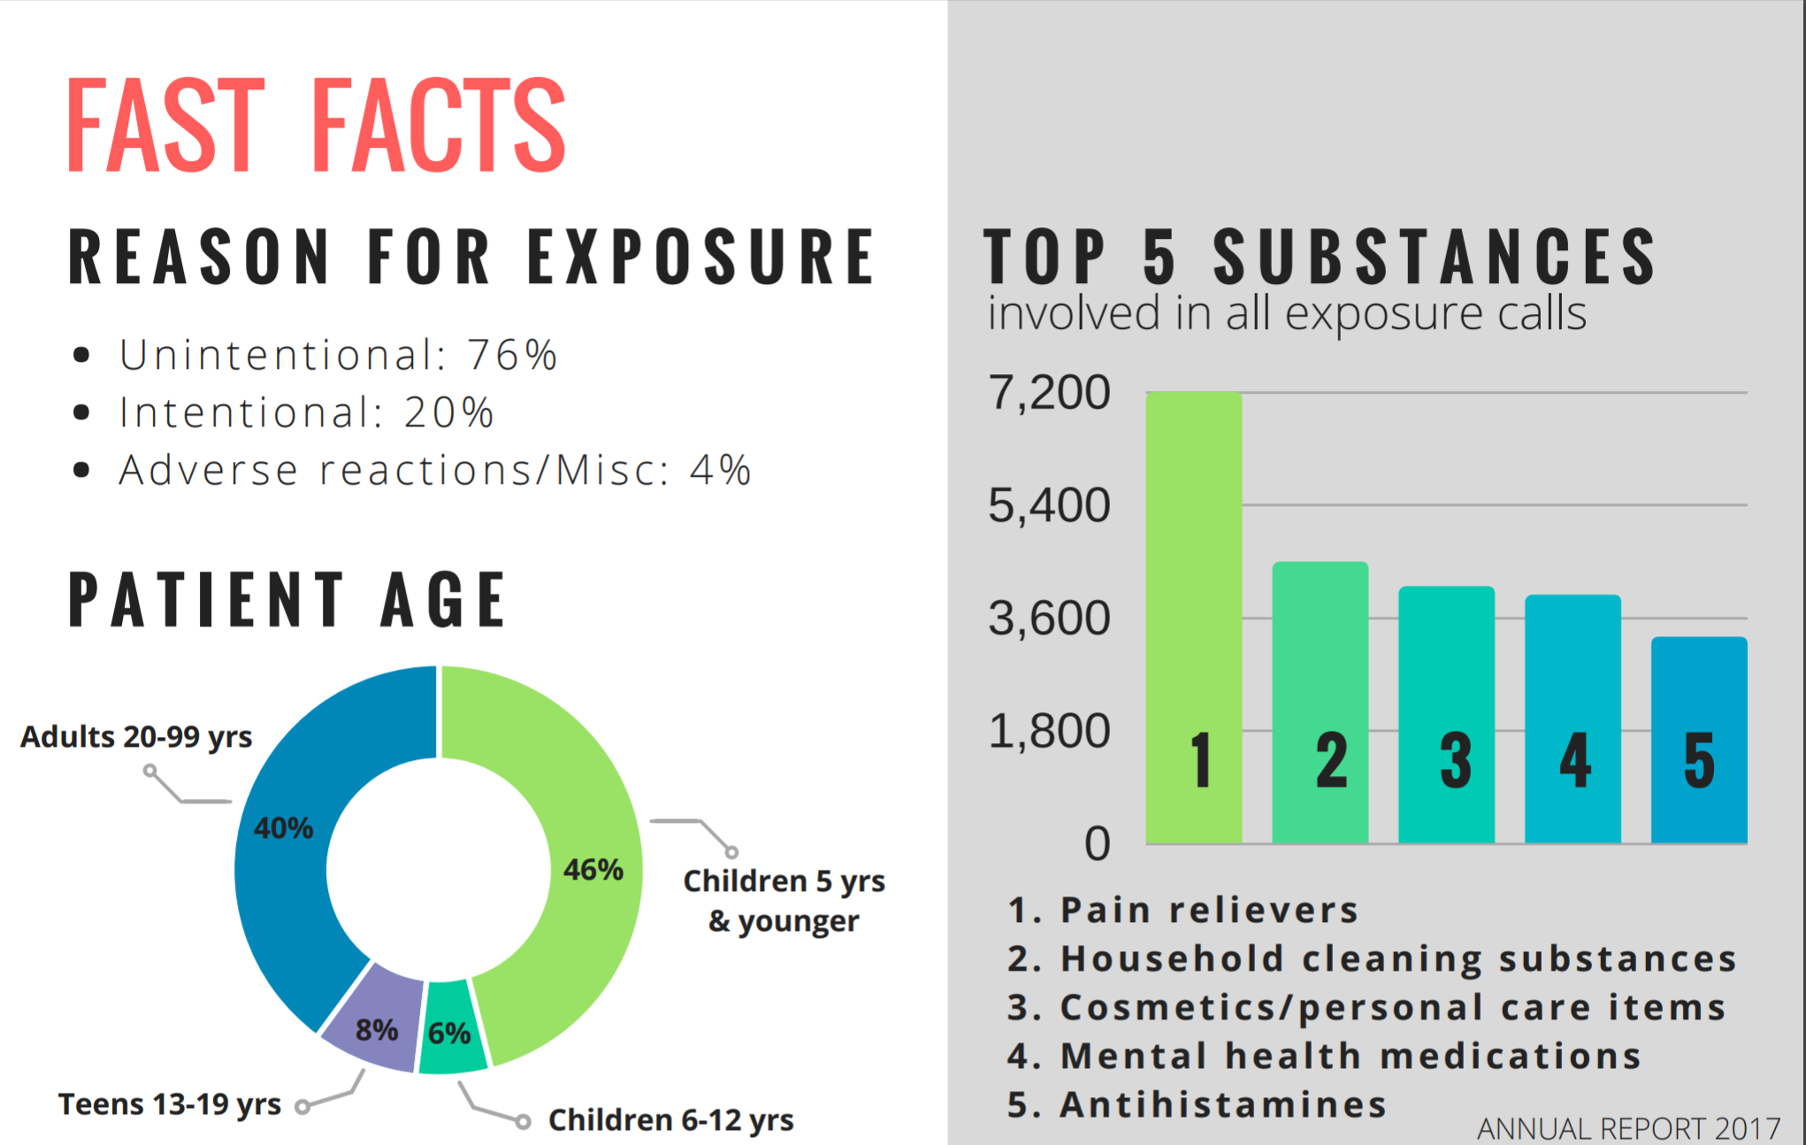
Project Poison – Missouri Poison Center

Slide 3
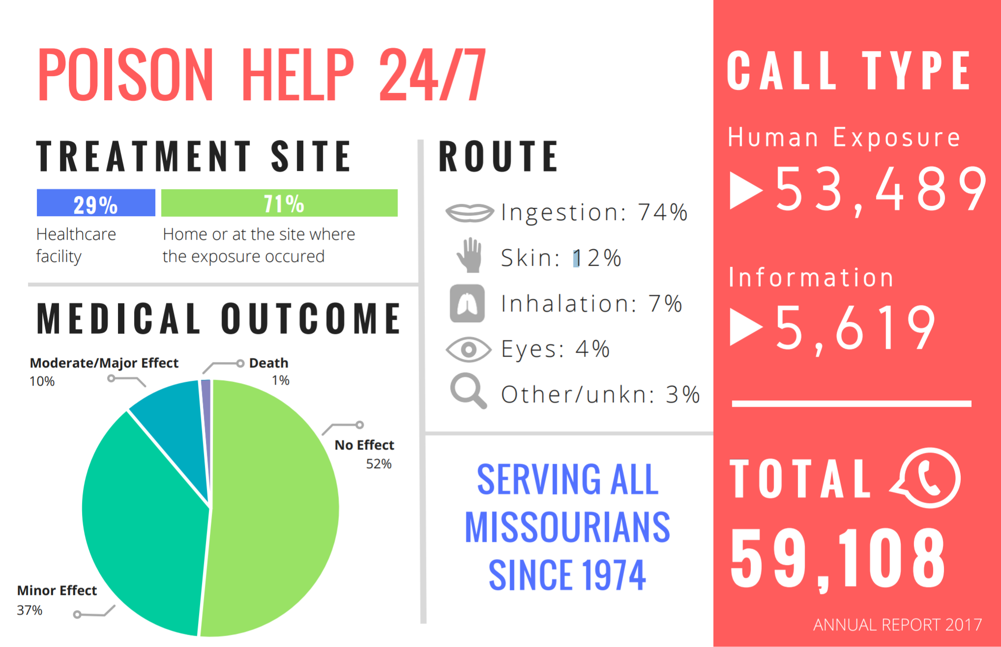
Project Poison – Missouri Poison Center

Slide 4
Project Title
Missouri Public Health Information System (MOPHIMS)
health data analysis of pertinent data
for the Missouri Poison Center
Team members: Nick Bergfeld, Courtney Charles, Tom Matoushek
Notes:
* Include the name of the Project and Group Members

Slide 5
Business Need
Missouri Poison Center has working and reference data bases (proprietary) used in its' daily mission of serving parents, educators and healthcare professionals.
There are other public data sets that have pertinent information of interest to the MPC. However, as a small non-profit, the center does not have the resources, budget or time to adequately explore them.

Slide 6
Project Goal
To provide the Missouri Poison Center with an overview analysis of data from the Missouri Public Health Information System (MOPHIMS) pertinent to MPC's mission.
MPC staff will then be able to compare Missouri public data with MPC internal data to assess if MPC services are being utilized at optimal levels across the state of Missouri

Slide 7
Hypothesis
Hypothesis: The Missouri Poison Center is underutilized in Missouri
Null Hypothesis: The poison center is being optimally utilized in Missouri
Our Team was not fully able to resolve our hypothosis due to project scope, complexity, duration and external dependencies
Notes:
* Define the core message or hypothesis of your project
* Describe whether you were able to answer these questions to your satisfaction, and briefly summarize your findings.

Slide 8
Research Questions
3 Initial Research Questions:
1) What are the data trends for child poison counts for all age groups 0 - 14?
2) What are the data trends for child poisons counts for BRFSS or LPHA Regions?
3) What are the data trends for child poisonings by types of poisonings: Household alcohol and substance abuse, accidental drug poisonings, opioid abuse/deaths, and carbon monoxide by age?
Notes:
* Describe the questions you asked, and _why_ you asked them

Slide 9
Data Cleanup & Exploration
Data from MOPHIMS was available in two formats:
Ready-to-open Excel files with extremely limited data slices
Query-generated extractable data files with inconsistent and problematic formatting
Query-generated extractable data files were un-readable in pandas
Rather than manually reformat the extacted files it was
suggested that we use python/panda data wrangling methods
Data wrangling attempts proved to be problematic and time consuming
> 50% of project time was spent data wrangling for some team members
Notes:
Describe the exploration and cleanup process
* Discuss insights you had while exploring the data that you didn't anticipate
* Discuss any problems that arose after exploring the data, and how you resolved them
* Present and discuss interesting figures developed during exploration, ideally with the help of Jupyter Notebook

Slide 10
Data Analysis
Using a combination of;
minimal manual file clean-up, standardizing data types, stacking, concatenating and pivoting, the team was able to analyze data and generate visualizations
The data set was then analyzed for trends by:
Years
Ages
Poisoning types
Notes:
* Discuss the steps you took to analyze the data and answer each question you asked in your proposal
* Present and discuss interesting figures developed during analysis, ideally with the help of Jupyter Notebook

Slide 11
Discussion
Notes:
* Discuss your findings. Did you find what you expected to find? If not, why not? What inferences or general conclusions can you draw from your analysis?

Slide 12
Post Mortem
As mentioned earlier, our team was not full able to prove our hypothesis
It should be first mentioned that this project has not been completed
Non-Class attempts will be made to provide a more complete solution to MPC
Project scope:
the project was larger in scope than anticipated – there was no scope creep
Complexity
Data wrangling proved to be the major technical obstacle to overcome
Duration
Two weeks was not enough
External Dependencies
The Team was reliant on outside input and comparison data
Notes:
* Discuss any difficulties that arose, and how you dealt with them
* Discuss any additional questions that came up, but which you didn't have time to answer: What would you research next, if you had two more weeks?

Slide 13
Project Poison
Questions???
Notes:
* Open-floor Q&A with the audience

